Slide 1
Power BI Training
Trainer:
Hariharan (767768)
November – 2020

Slide 2



About Trainer
Hariharan Rajendran
Microsoft MVP in Data Platform
Microsoft Certified Trainer & Certified CompTIA Class Room Trainer
Certified Power BI Expert
http://dataap.org/blog/author/hariharanr/
https://youtube.com/dataonmyview
Hariharan.Rajendran@Cognizant.com (767768)

Slide 3
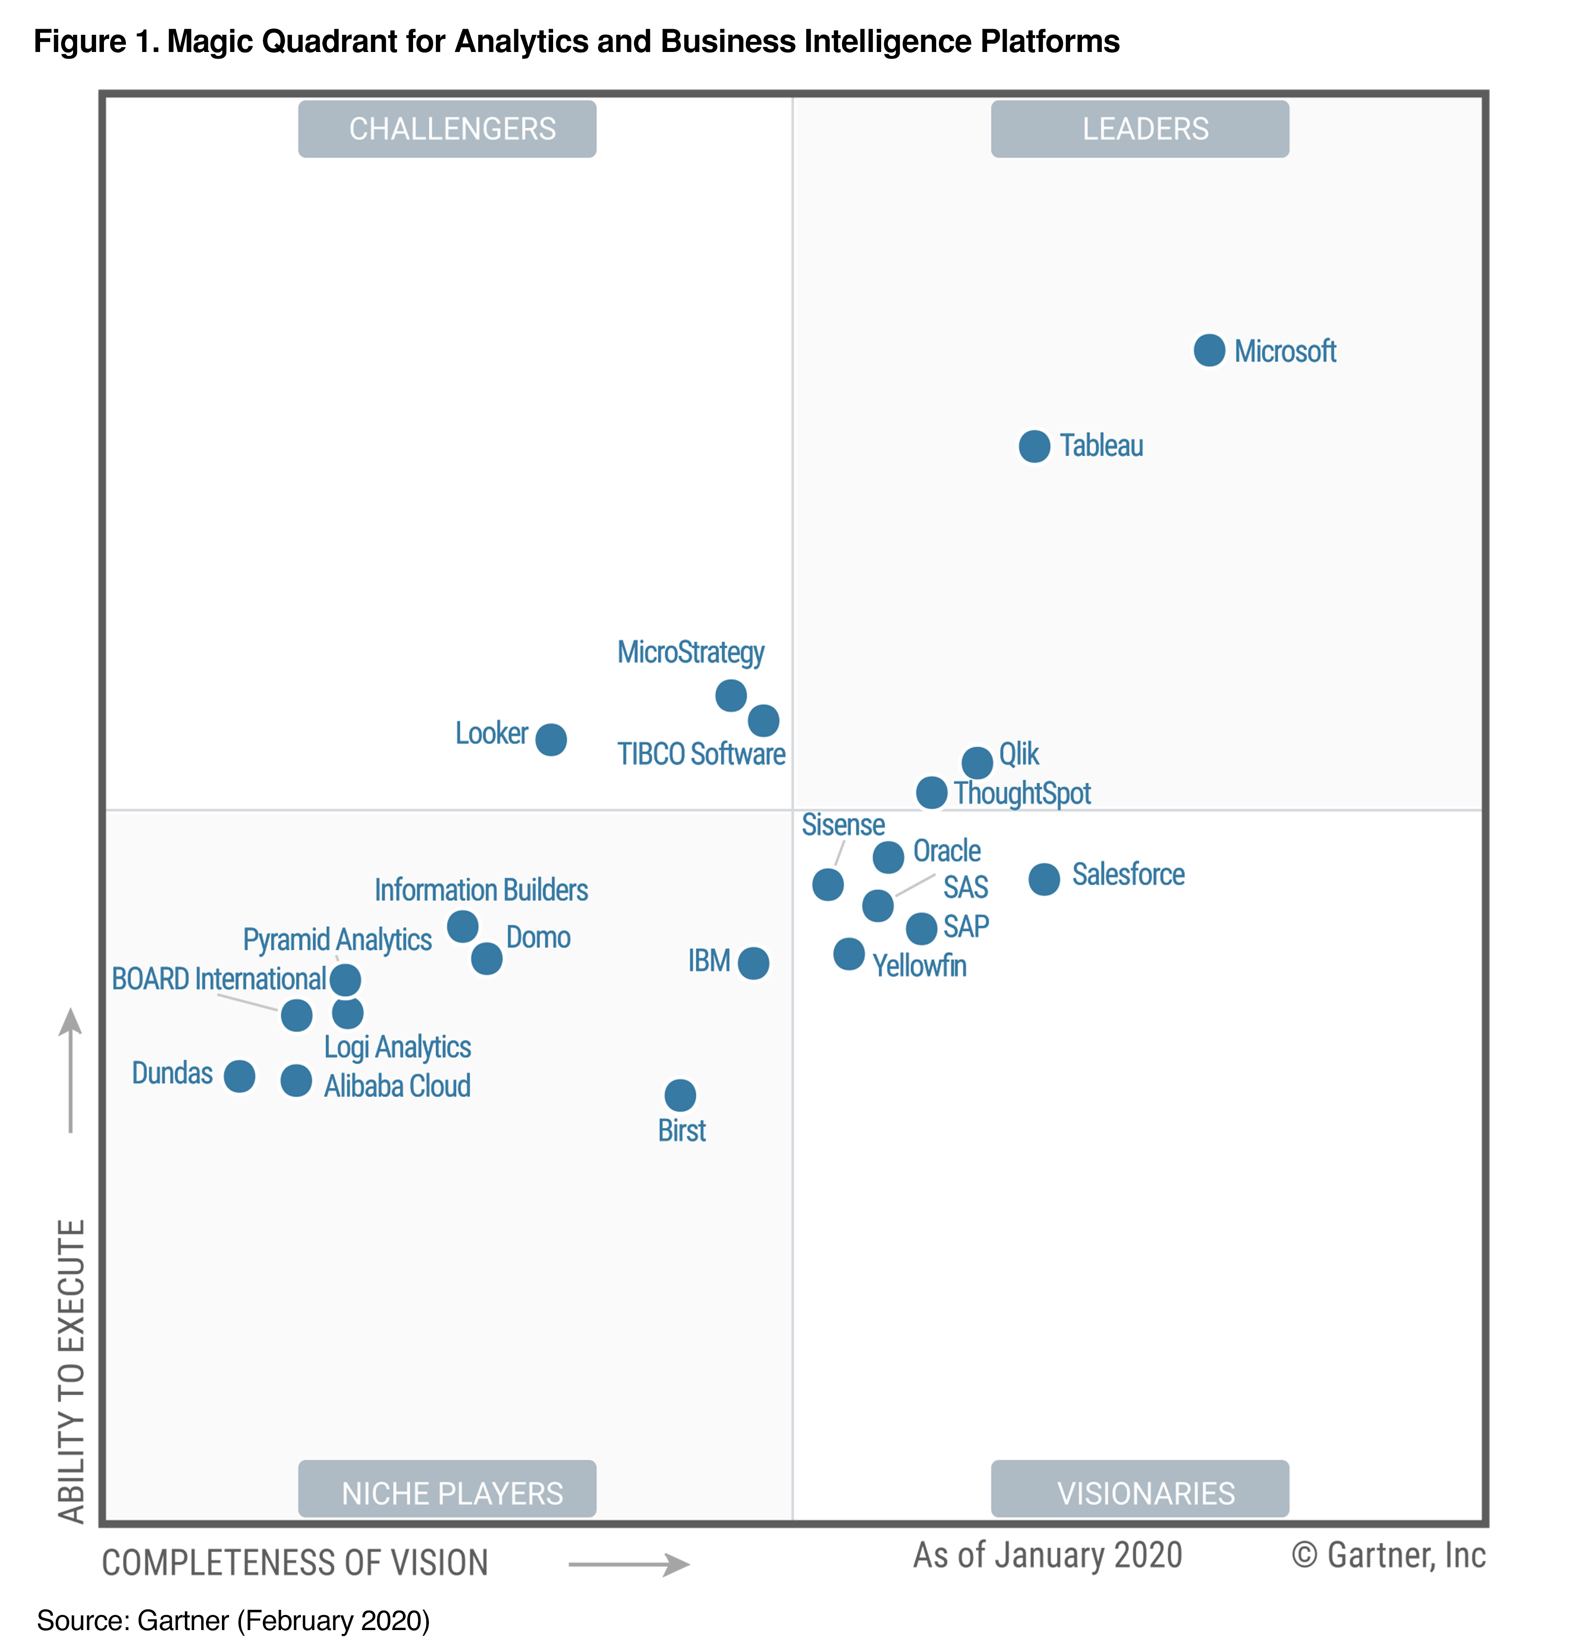
Why Microsoft BI?
Cloud First & Mobile First
More investment in Azure
Core Analytical Engine
Adoption Models
Monthly Update
Cloud & on-Prem

Slide 4
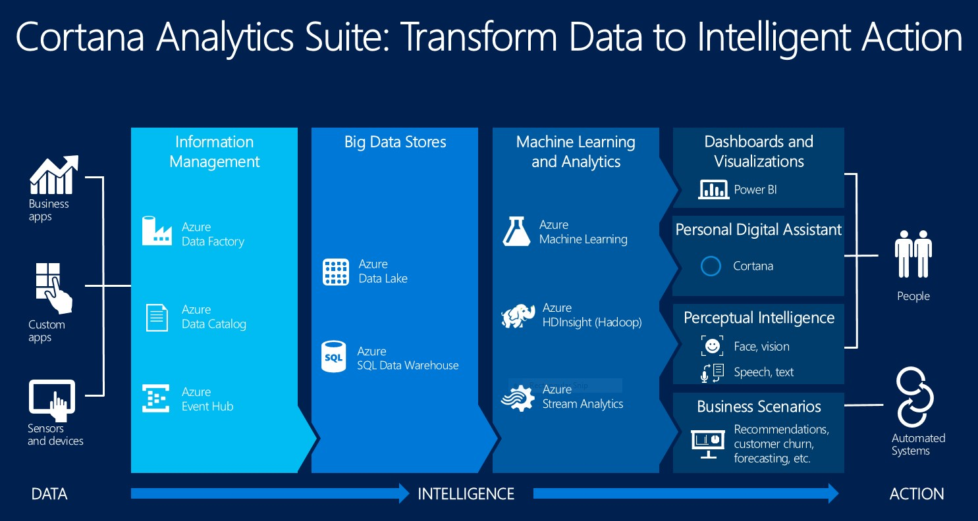

Slide 5
History
Microsoft unveiled the first preview to its business intelligence service also called Power BI within Office 365 developed basically for customers to track down data about their businesses in September 2014.
The first release of Power BI released on 24 July 2015 and was based on Excel Based Add ins: Power Pivot, Power Query, Power view and Power Map.
With time Microsoft has added more features like Question and Answers, enterprise level data connectivity and security options via Power BI Gateways, Power BI Report server for On-Premise report publishing, Power BI Premium and a lot more.

Slide 6
Excel Based Power BI
Power Query or Query ETL (Data extraction, Transform, Load)
Power Pivot or Data model Data Modelling
Power View or Reports Visualizations
Power Query
Microsoft Power Query for Excel enhances self-service business intelligence (BI) for Excel with an intuitive and consistent experience for discovering, combining, and refining data across a wide variety of sources including relational, structured and semi-structured, OData, Web, Hadoop, Azure Marketplace, and more
Power Pivot
Power Pivot is an Excel add-in you can use to perform powerful data analysis and create sophisticated data models. With Power Pivot, you can mash up large volumes of data from various sources, perform information analysis rapidly, and share insights easily.
Power View
It is an interactive data exploration, visualization, and presentation experience that encourages intuitive ad-hoc reporting

Slide 7
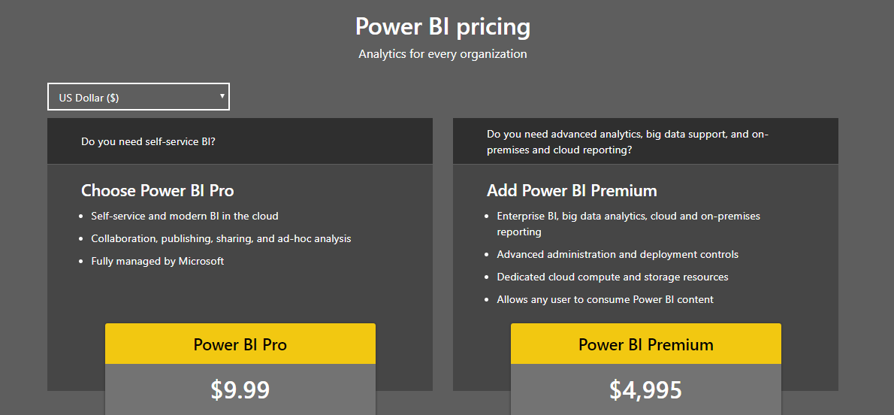
Licensing

Slide 8
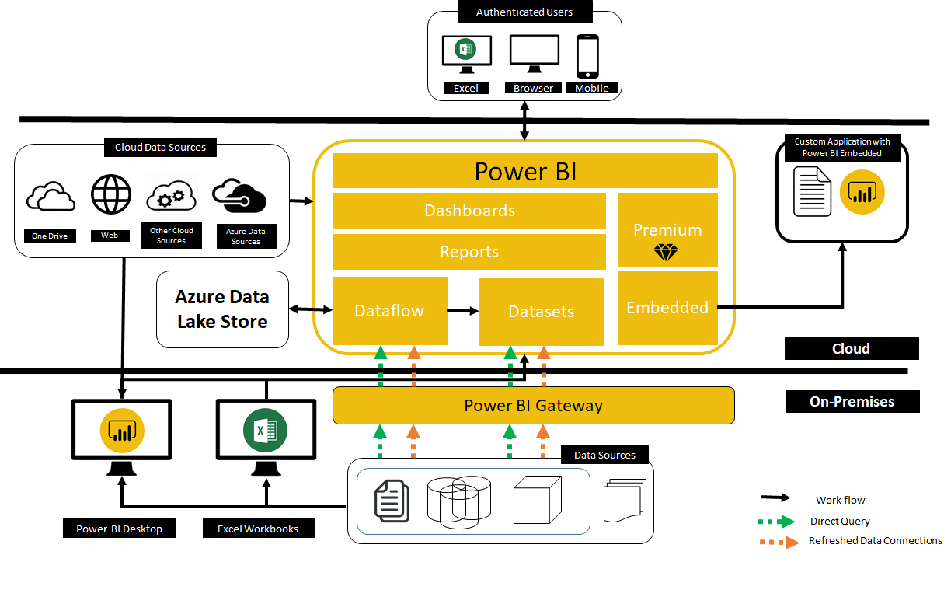
Architecture

Slide 9
End-to-End Approach
Data Load & Shape
Extract data from data sources
Shape the data using Power Query
Data Model
Create relationships
Build analytical calculations using DAX
Reports & Dashboards
Create reports
Publish reports
Create dashboards

Slide 10
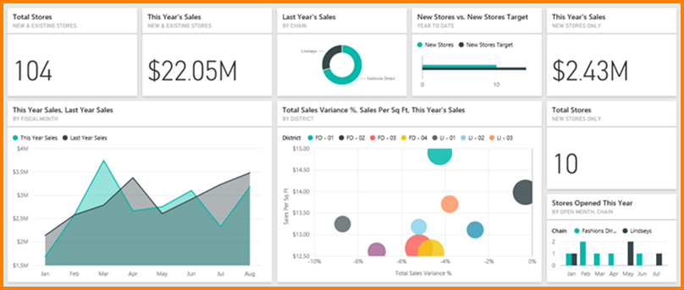
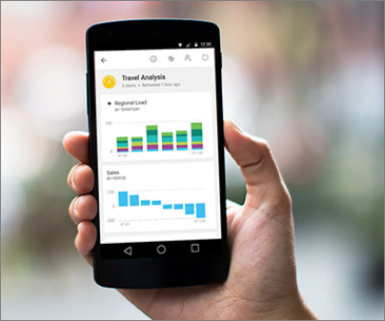
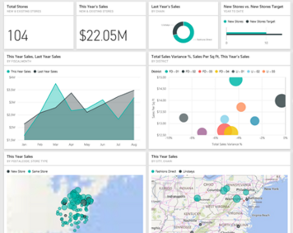
Overview
Why Tableau?
Leverages the power of In-memory processing to provide interactive and Custom visualizations.
Faster time to implement compared to traditional BI
Supports All Microsoft Azure and a wide range of other (non Microsoft) data sources (both on - premise and cloud)
Publish to Web
Cloud based Service with excellent scalability
Cloud based platform which can be setup in minutes without any necessity of on - premise infrastructure.
On-Premise report publishing
Excellent Data Discovery features
Mobile BI- View the dashboards/Reports in iPad, iPhone, Android and Windows Devices
Allows Scheduled Data Refresh

Slide 11
Power BI – Tools and Components
App | Description | Cost
PowerBI Desktop | Report Authoring Tool | Freely Available
Power BI Desktop for Report Server | Report Authoring Tool exclusive for On premise report server hosting | Freely Available
PowerBI Service | Service on Azure cloud used to publish PowerBI reports | Pro User (9.99$/user/month)
 | PowerBI reports can also be authored here
 | SaaS Offering from Microsoft
PowerBI Mobile | Native Mobile Apps to view PowerBI reports/dashboards on windows/Android/iOS devices | Apps can be downloaded from respective App stores
PowerBI Embedded | To integrate Power BI reports into web or mobile applications. | Licensing based on per report session.
Power BI Premium | Power BI Premium is dedicated capacity for your organization or team, giving you more consistent performance and larger data volumes, without requiring you to purchase per-user licenses. | https://powerbi.microsoft.com/en-us/calculator/
Notes:
Notification to User 1 Stating the Success of the Process

Slide 12
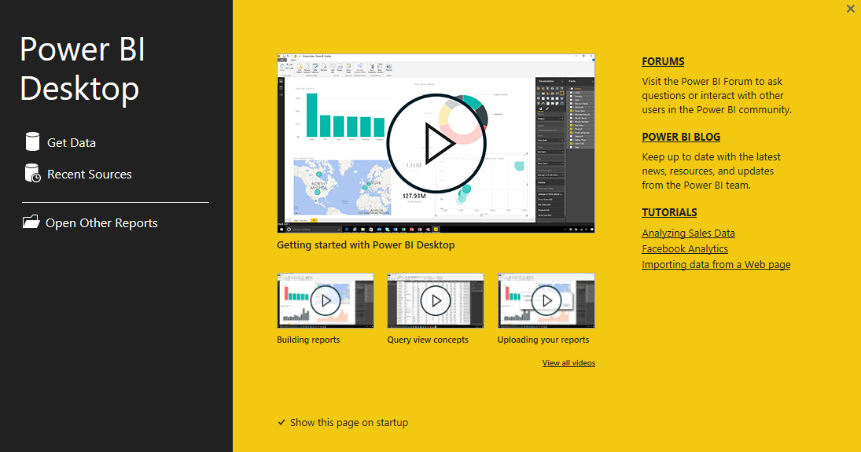
Power BI Desktop – First View
When you launch Power BI Desktop, a Welcome screen is displayed.
Minimum requirements
BI Desktop:
Windows 7 / Windows Server 2008 R2, or later
.NET 4.5
Internet Explorer 9 or later
Memory (RAM): At least 1 GB available, 1.5 GB or more recommended.
Display: At least 1440x900 or 1600x900 (16:9) recommended. Lower resolutions such as 1024x768 or 1280x800 are not recommended, as certain controls (such as closing the startup screen) display beyond those resolutions.
CPU: 1 gigahertz (GHz) or faster x86- or x64-bit processor recommended.

Slide 13
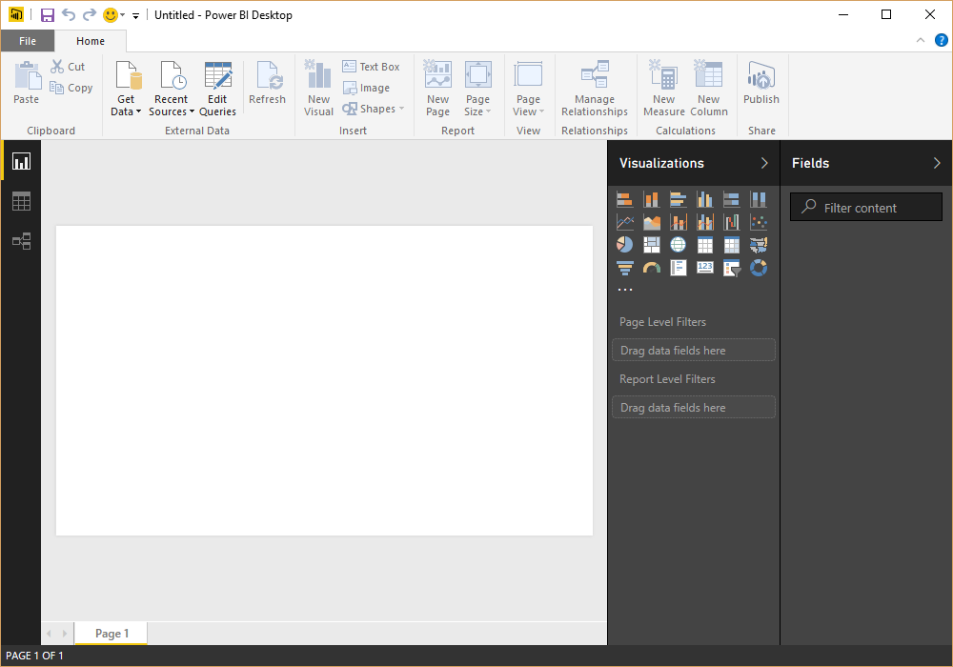
Power BI Desktop
Left Menu options to toggle between report screen, data model and relationships
Report Canvas
Options and settings to interact with visuals
Area to select your data
Connect to your data using Queries
5
1
2
3
4

Slide 14
Power BI Queries – Connect to Data

Slide 15
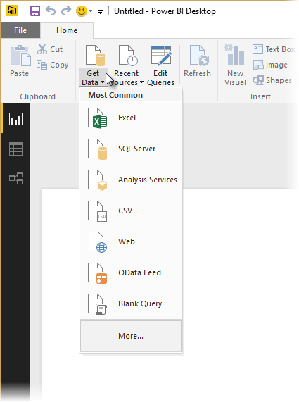
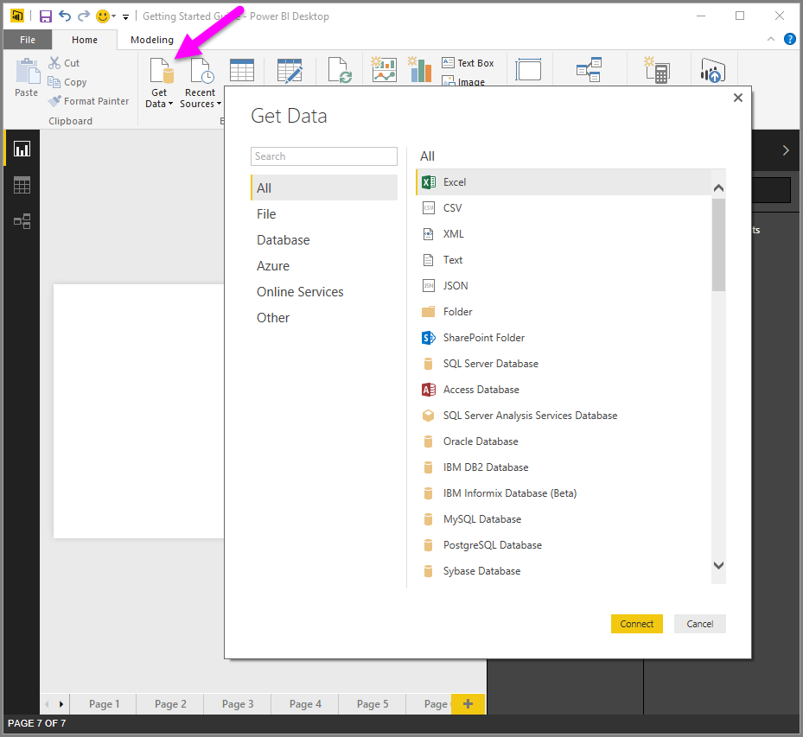
Data sources in Power BI Desktop
With Power BI Desktop, you can connect to data from many different sources. To connect to data, select Get Data from the Home ribbon. Selecting the down arrow, or the Get Data text on the button, shows the Most Common data types menu shown in the following image.

Slide 16
Data Connectivity
Import
Direct Query
Connect Live

Slide 17
Data Connectivity
Capability | Import | DirectQuery
Size | Up to 1 GB per dataset | No limitation
Data Source | Import data from Multiple sources | Data must come from a single Source
Performance | High-performance query engine | Depends on the data source response for each query
Data Change in the underlying data | Not Reflected. Required to do a Manual refresh in Power BI Desktop and republish the report or Schedule Refresh | Power BI caches the data for better performance. So, it is necessary to Refresh to ensure the latest data
Schedule Refresh | Maximum 8 schedules per day | Schedule often as every 15 mins
Power BI Gateway | Only required to get latest data from On-premise data sources | Must require to get data from On-premise data sources
Data Transformations | Supports all transformations | Supports many data transformations with some limitations
Data Modelling | No limitation | Some limitations such as auto-detect relationships between tables and relationships are limited to a single direction.
Built-in Date Hierarchy | Available | Not available
DAX expressions | Supports all DAX functions | Restricted to use complex DAX functions such as Time Intelligence functions. However, if there is a Date table available in the underlying source then it supports
Clustering | Available | Not available
Calculated Tables | Available | Not supported
Quick Insights | Available | Not available
Q&A | Available | Not available
Change Data Connectivity mode | Not possible to change Import to DirectQuery | Possible to change DirectQuery to Import

Slide 18
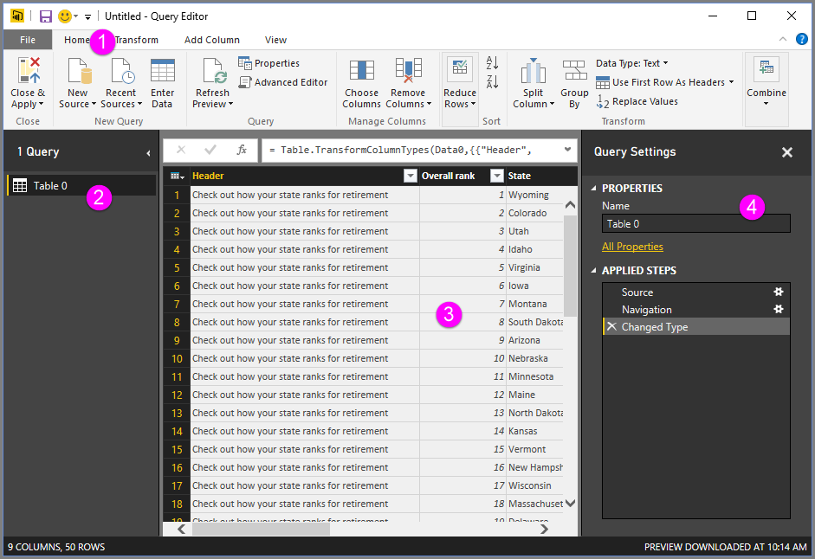
Query Editor
Different options to interact with the data
Left pane which list different queries.
Center pane that displays data from the current query
The Query Settings window appears, listing the query’s properties and applied steps

Slide 19
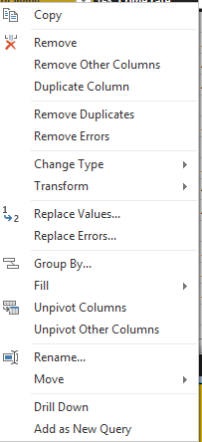
Query Editor – Column Options

Slide 20
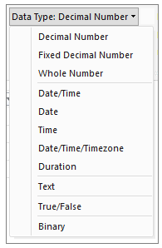
Data Types in Power BI Desktop
When you load data into Power BI Desktop, it will attempt to convert the data type of the source column into a data type that better supports more efficient storage, calculations, and data visualization.
For example, if a column of values you import from Excel has no fractional values, Power BI Desktop will convert the entire column of data to a Whole Number data type, which is better suited for storing integers.
In Power BI Desktop, you can determine and specify a column’s data type in the Query Editor
More Details - https://powerbi.microsoft.com/en-us/documentation/powerbi-desktop-data-types/

Slide 21
Power BI Queries – Common Query Tasks

Slide 22
Common Query Tasks
The common Query tasks demonstrated here are the following:
Connect to Data
Shape and Combine Data
Group Rows
Pivot Columns
Create Custom Columns
Query Formulas
--------A Typical SQL Query --------
SELECT A.Column1, B.Column2,
SUM(A.Column2) Summary,
FROM
TableA A
LEFT JOIN TableB B ON A.ID = B.ID
GROUP BY
A.Column1, B.Column2
Where
A.Column3 = “Condition”

Slide 23
Shape and Combine data in Power BI Desktop
With Power BI Desktop, you can connect to many different types of data sources, then shape the data to meet your needs.
Shaping data means transforming the data – such as renaming columns or tables, changing text to numbers, removing rows, setting the first row as headers, and so on.
Combining data means connecting to two or more data sources, shaping them as needed, then consolidating them into one useful query

Slide 24
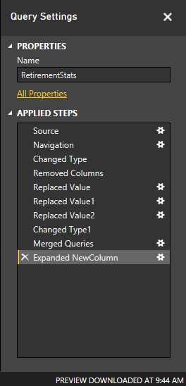
Shape Data
When you shape data in the Query Editor, you’re providing step-by-step instructions (that Query Editor carries out for you) to adjust the data as Query Editor loads and presents it.
The original data source is not affected; only this particular view of the data is adjusted, or shaped
Common Tasks:
First row as header
Renaming columns
Row selection
Column selection
Data type conversion
Replace values
Split columns
Fill values
New Columns
Adding Index
Pivot – Unpivot Operations
Transpose Data

Slide 25
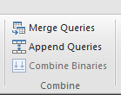
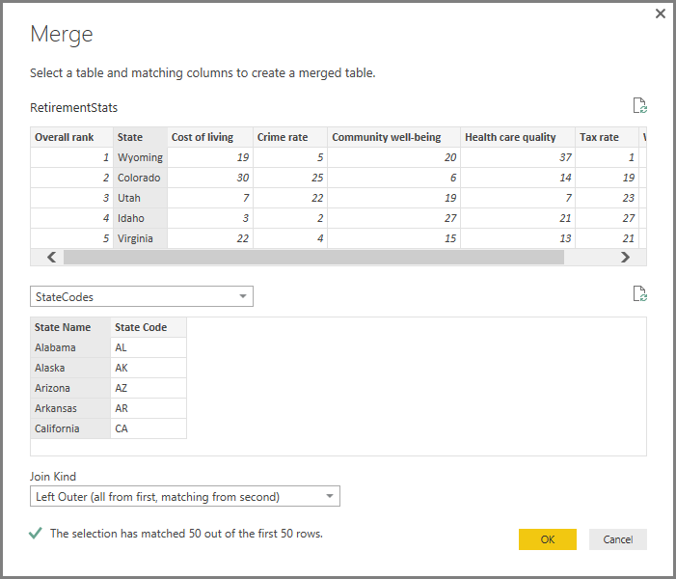
Combine Data
There are two primary ways of combining queries – merging and appending.
When you have one or more columns that you’d like to add to another query, you merge the queries.
When you have additional rows of data that you’d like to add to an existing query, you append the query.
Common Tasks:
Merge Queries
Append Queries
Group By Operations

Slide 26
PowerBI - Modelling

Slide 27
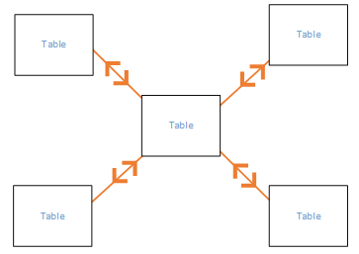
Relationships
Relationships between tables are necessary in order to accurately calculate results and display the correct information in the reports.
Power BI Desktop makes creating those relationships easy through Autodetect feature.
Autodetect during load
If you query two or more tables at the same time, when the data is loaded, Power BI Desktop will attempt to find and create relationships for you. Cardinality, Cross filter direction, and Active properties are automatically set. Power BI Desktop looks at column names in the tables you are querying to determine if there are any potential relationships. If there are, those relationships are created automatically.

Slide 28
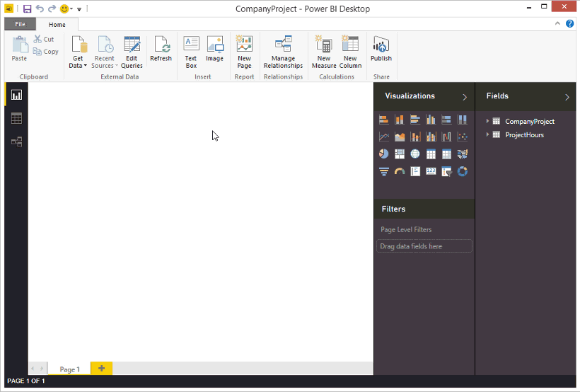
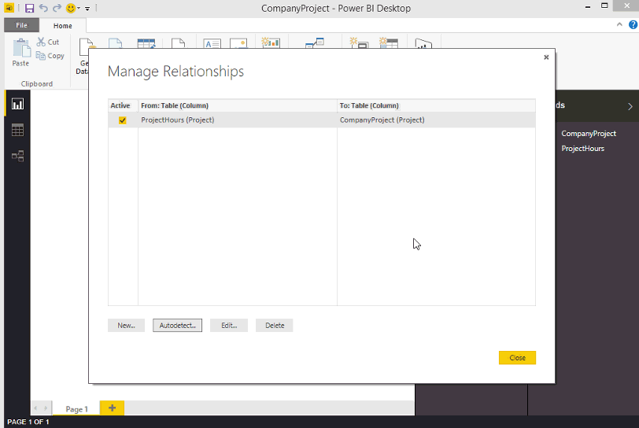
Creating Relationships
Create a relationship by using Autodetect
On the Home tab
click Manage Relationships > AutoDetect.
Create a relationship manually
On the Home tab, click Manage Relationships > New.
In the Create Relationship dialog, in the first table drop-down list, select a table, and then select the column you want to use in the relationship.
In the second table drop-down list, select the other table you want in the relationship, then select the other column you want to use, and then click OK.
Edit a relationship
On the Home tab, click Manage Relationships.
In the Manage Relationships dialog,
select the relationship, then click Edit.
https://powerbi.microsoft.com/en-us/documentation/powerbi-desktop-create-and-manage-relationships/

Slide 29
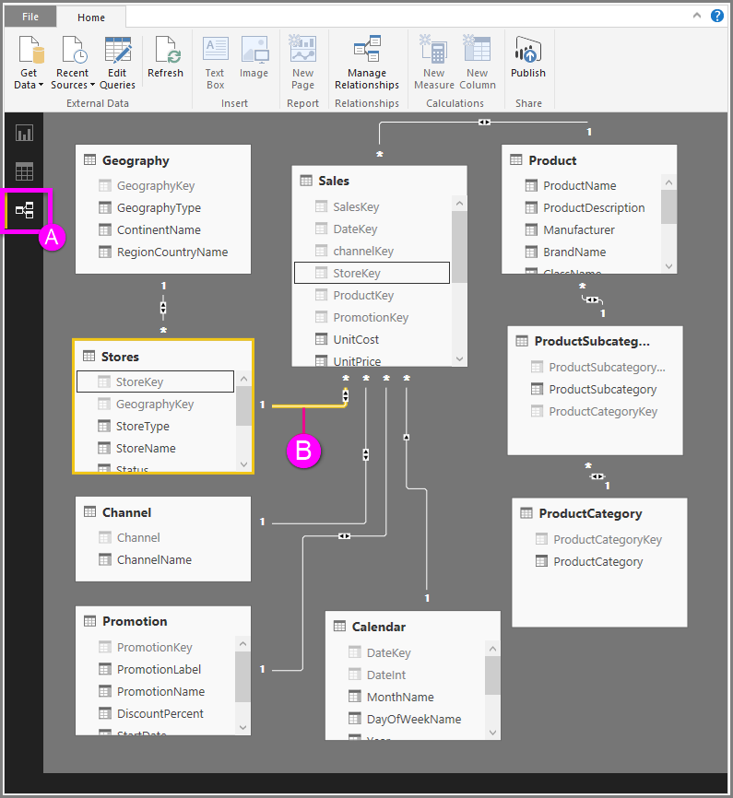
Relationship View in Power BI Desktop
A. Relationship View icon – Click to show your model in Relationship View
B. Relationship – You can hover your cursor over a relationship to show the columns used. Double-click on a relationship to open it in the Edit Relationship dialog box.
In the figure above, you can see the Stores table has a StoreKey column that’s related to theSales table, which also has a StoreKey column.
We see it’s a Many to One (*:1) relationship, and the icon in the middle of the line shows the Cross filter direction set to Both. The arrow on the icon shows the direction of the filter context flow.

Slide 30
Relationships
Cross Filter Direction | Cardinality
Both - This is the most common, default direction. This means for filtering purposes, both tables are treated as if they're a single table. | Many to One (*:1) - This is the most common, default type. This means the column in one table can have more than one instance of a value, and the other related table, often know as the Lookup table, has only one instance of a value.
Single - This means that filtering choices in connected tables work on the table where values are being aggregated | One to One (1:1) - This means the column in one table has only one instance of a particular value, and the other related table has only one instance of a particular value

Slide 31
DAX - Data Analysis Expressions

Slide 32
When DAX?
What is DAX?
DAX is a collection of functions, operators, and constants that can be used in a formula, or expression, to calculate and return one or more values. Stated more simply, DAX helps you create new information from data already in your model.
If we need to analyze growth percentage across product categories and for different date ranges
If we need to calculate year-over-year growth compared to market trends
And in many other such scenarios.
DAX formulas will help you get the most out of your data. This is the power in Power BI, and DAX will help you get there.

Slide 33
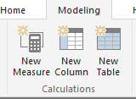
Purpose of DAX
Calculated Columns
Value is computed for each row
Materialized in tables as a static column – It consumes memory
It can be used for slicers and filters
All rows contain same formula.
Calculated Measures
Numeric calculation
Not Materialized
Dynamic – Does not consume memory
Evaluated for each row based on the given context.

Slide 34
PowerBI Visuals

Slide 35
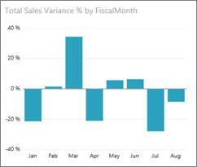
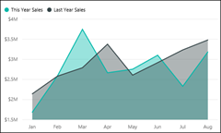
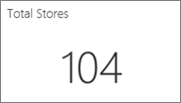
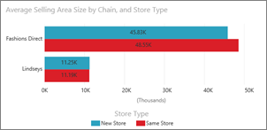
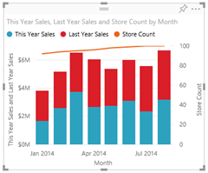
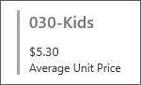
Power BI visualizations
Bar and column charts
Basic (Layered) and Stacked Area charts
Single number cards
Tip: The Basic Area chart is based on the line chart with the area between the axis and line filled in.
Multi row cards
Combo charts
Tip: A Combo chart combines a column chart and a line chart.
Choose from Line and Stacked Column and Line and Clustered Column.

Slide 36
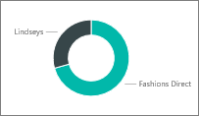
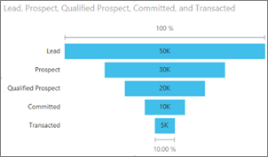
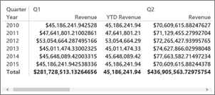
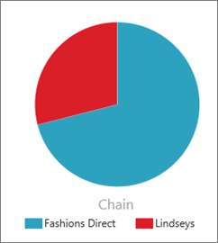
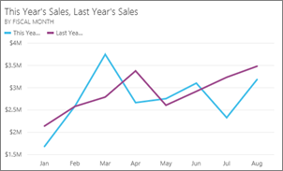
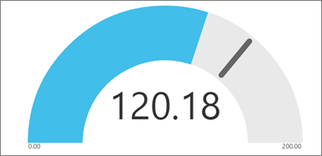
Power BI visualizations
Doughnut charts
Tip: Doughnut charts are similar to Pie charts.
They show the relationship of parts to a whole.
Funnel charts
Tip: Funnels help visualize a process that has stages
and items flow sequentially from one stage to the next.
Matrix
Pie charts
Gauge charts
Tip: Displays current status in the context of a goal.
Line charts
Tip: emphasize the overall shape of an entire
series of values,
usually over time.

Slide 37
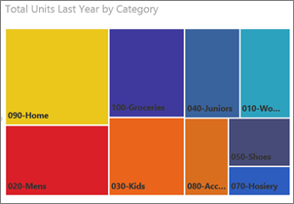
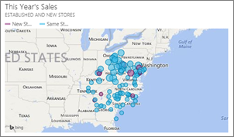
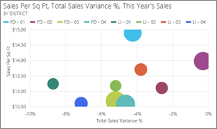
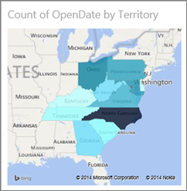
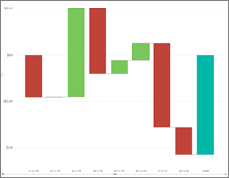
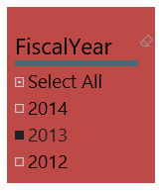
Power BI visualizations
Maps (basic)
Tree Maps
Scatter and Bubble charts
Filled Maps (Choropleth)
Slicers
Waterfall charts
Tip: Waterfall charts show a running total as values are added or subtracted.
Tip: The more intense the color, the larger the value.

Slide 38
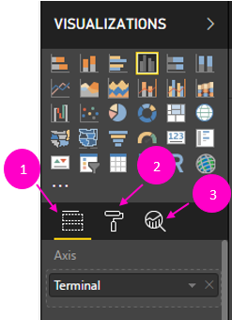
Visualization Pane
This is the pane from where we can pick a visual from stack of numerous classic visuals and custom visuals.
Directly below the available visualizations are the three icons: the Fields (a stack of bars), Format (a paintbrush) and Analytics (a magnifying glass) icons. The Analytics icon appears only after selecting a visual.
We will discuss about each icon in detail in upcoming slides

Slide 39
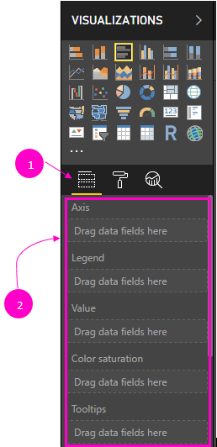
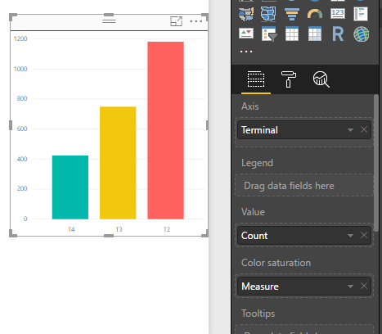
Visualization Pane - Fields icon
In the left image the Fields icon is selected, indicated by a yellow bar below the icon.
Respective values for fields has to be dragged and dropped in the respective place.
Commonly available elements under Field icons are:
Axis
Legend
Values
Tooltips
Note: The available options vary depending on the type of visual that has been selected.

Slide 40
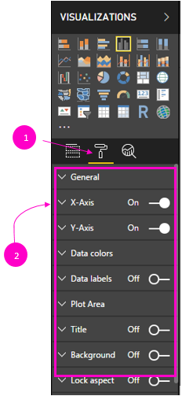
Visualization Pane – Format icon
When you select Format, the area below the icon displays the color and axis customizations available for the currently selected visualization.
You can customize many elements of each visualization such as:
Legend
X-Axis
Y-Axis
Data Colors
Data Labels
Category Labels
Title
Background and many more
Note: The available options for cosmetic changes to your visual vary depending on the type of visual you have selected.

Slide 41
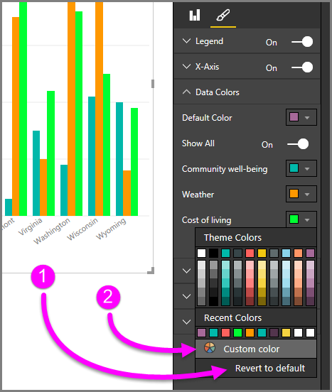
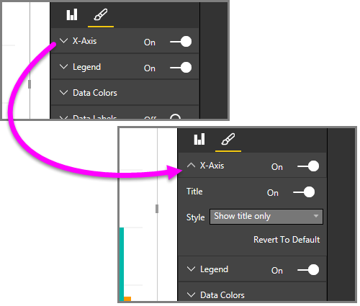
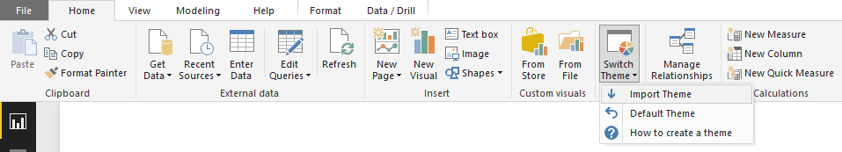
Visualization Pane
Working with Colors
Changing Axis Properties
Changing Colors Theme

Slide 42
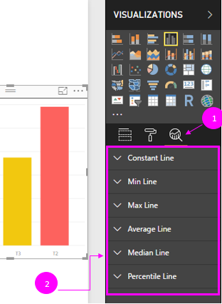
Visualization Pane – Analytics icon
With the Analytics pane, you can add dynamic reference lines to visuals, and provide focus for important trends or insights. Beginning with the February 2018 release of Power BI Desktop (version 2.55.5010.201 or later), you can search within the Analytics pane
With the Analytics pane, you can create the following types of dynamic reference lines
X-Axis constant line
Y-Axis constant line
Min line
Max line
Average line
Median line
Percentile line
Note: The ability to use dynamic reference lines is based on the type of visual being used.

Slide 43
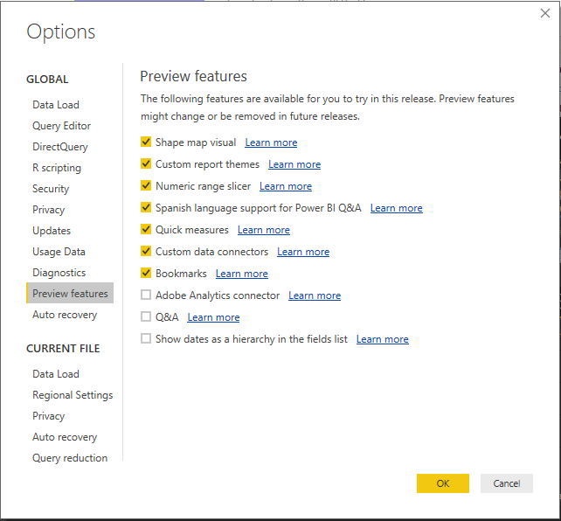
Preview Features
The following steps describe how to enable the Preview Features:
In Power BI Desktop, select File > Options and settings > Options.
Select Preview Features from the Global section, in the left side of the Options window.
List of Preview Features will be displayed.

Slide 44
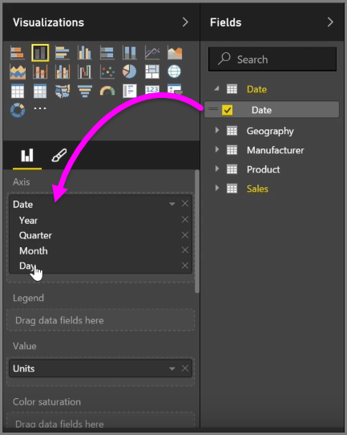


Visual hierarchies and drill-down behavior
When you add a date field to a visual in the Axis field bucket, Power BI automatically adds a time hierarchy that includes Year, Quarter, Month and Day.

Slide 45



Drill Through behavior
With drillthrough you can create a page in PowerBI report that focuses on a specific entity. With that focused report page, you can right-click on a data point in other report page and drillthrough to the focused page to get details that are filtered to that context.

Slide 46

Custom Visualizations in Power BI
The Power BI visuals gallery provides custom visualizations which are created by the members of the community and by Microsoft.
These Visualizations behave just like the native visualizations which can filtered, highlighted, shared, edited, etc.
Important: A custom visual template is added to a specific report when imported. If you'd like to use the visual template in another report, you need to import it into that report as well. When a report with a custom visual is saved using the Save As option, a copy of the custom visual template is saved with the new report.

Slide 47

Custom Visualizations in Power BI
Few latest Custom Visuals
Power KPI
Histogram with points
Journey Chart
Image Grid
Tachometer
Heat map
Chiclet Slicer
Venn Diagram
Important: A custom visual template is added to a specific report when imported. If you'd like to use the visual template in another report, you need to import it into that report as well. When a report with a custom visual is saved using the Save As option, a copy of the custom visual template is saved with the new report.

Slide 48





Custom visual to a report (Desktop)
From the Desktop File menu
On the report File menu, choose Import > Custom Visual from File and Custom visual from Store.
On Home menu, under Custom Visuals tab > Custom Visual from File and Custom visual from Store
From the Visualization pane – Import from File
In the Visualizations pane, choose Insert (…). > Insert from File
Select a .pbiviz file in the Open dialog.

Slide 49






Custom visual to a report (Desktop)
From the Visualization pane – Import from Store
In the Visualizations pane, choose Insert (…). > Insert from Store
Removing custom visual from a report
In the Visualizations pane, choose Insert (…). > Delete a Custom Visual
Select a custom visual that has to
be deleted and click delete

Slide 50


Bookmark
Using bookmarks in Power BI you can capture the currently configured view of a report page, including filtering and the state of visuals, and later go back to that state by simply selecting that saved bookmark.
Enabling the bookmarks preview
To enable this preview feature, select File > Options and Settings > Options > Preview Features > Bookmarks.
To use bookmarks, select the View ribbon, then select the box for Bookmarks Pane.
When you create a bookmark, the following elements are saved with the bookmark:
The current page
Filters
Slicers
Sort order
Drill location
Visibility (of an object, using the Selection pane)
The focus or Spotlight modes of any visible object

Slide 51



Bookmark
select Add from the Bookmarks pane to add a bookmark.
You can easily rename a bookmark, delete it, or update a bookmark by selecting the ellipses(…) next to the bookmark's name
Bookmarks as a slide show
When you have a collection of bookmarks you would like to present, in order, you can select View from the Bookmarks pane to begin a slideshow.
When in View mode, there are a few features to notice:
The name of the bookmark
next or previous bookmark
You can exit View mode by selecting Exit from the
Bookmarks pane
Bookmarks for shapes and images
To assign a bookmark to an object, select the object,
then select Link from the Format Shape pane, as shown in the
following image.

Slide 52


Spotlight
With Spotlight you can draw attention to a specific chart
Let's compare Spotlight to focus mode to see how they differ.
1. In focus mode, you can have one visual fill the entire canvas by selecting the focus mode icon.
2. Using Spotlight, you can highlight one visual in its original size, by making all other visuals on the page fade to near transparency

Slide 53

Power BI Workspace
Office 365 app
Launcher
Power BI
Home Button
Help and Feedback Buttons
Navigation Bar
Additional Dashboard Buttons
Dashboard Title
Q & A Box
Dashboard with tiles

Slide 54



PowerBI Security (RLS)
Row Level Security (RLS) is implemented at PowerBI Desktop based on their roles.
Users will be added to the Roles in PowerBI Service.

Slide 55

PowerBI Gateway
A gateway is software that facilitates access to data that resides on a private, on-premises network.
A gateway also secures access and data by encrypting and compressing all data that passes through it, as well as any passwords used to connect to data sources
Two gateway offerings from Power BI are the following:
On-premises data gateway (personal mode) – allows one user to connect to sources, and can’t be shared with others. Can only be used with Power BI.
On-premises data gateway – allows multiple users to connect to multiple on-premises data sources, and can be used by Power BI, PowerApps, Flow, and Azure Logic apps, all with a single gateway installation.
There are three parts, or stages, to putting a gateway to work:
Install the gateway
Add users to the gateway (let them use the gateway)
Connect to data sources
In addition, gateway allows to Refresh on-premises data, so Power BI reports
can be updated with fresh data

Slide 56


Machine 1
M2

Slide 57


PowerBI Administration
Power BI provides an admin portal that allows you to
Usage Metrics
Manage users and groups
Audit Logs
Control tenant wide settings.

Slide 58

PowerBI Embedded
Easy to Integrate PowerBI reports to any Web page or mobile applications.
Easy to embed interactive visuals in any app using REST APIs and the Power BI SDK
Ensure consistent high-fidelity interactive data visualization experiences on any device
Reuse existing authentication and authorization methods.
Speed up time to value without redesigning existing app
Session based cost.
Read More about PowerBI Embedded : https://azure.microsoft.com/en-in/services/power-bi-embedded/

Slide 59


Slide 60
Perspectives
End Users
Developers
Admin

Slide 61
Demo

Slide 62
Useful links
Power BI – Getting Started | Get Power BI Desktop | https://powerbi.microsoft.com/en-us/documentation/powerbi-desktop-get-the-desktop/
 | Getting Started with Power BI Desktop | https://powerbi.microsoft.com/en-us/documentation/powerbi-desktop-getting-started/
 | Power BI Desktop Videos | https://powerbi.microsoft.com/en-us/documentation/powerbi-desktop-videos/
 | What’s new in latest Power BI Desktop | https://powerbi.microsoft.com/en-us/documentation/powerbi-desktop-latest-update/
Ideas |  | https://ideas.powerbi.com/forums/265200-power-bi-ideas
Power BI Webinars |  | https://powerbi.microsoft.com/en-us/documentation/powerbi-webinars/
Power BI Blog |  | https://powerbi.microsoft.com/en-us/blog/
Power BI Community |  | http://community.powerbi.com/
Power BI Support |  | https://powerbi.microsoft.com/en-us/support/
Guy in a cube | YouTube Channel | https://www.youtube.com/channel/UCFp1vaKzpfvoGai0vE5VJ0w
Why Tableau?

Slide 63
Thank You

Slide 64
M Query
let
var1 = “Hello “,
var2 = “World”,
Result = var1 & var2
in
Result
let
Result = var1 & var2
var1 = “Hello “,
var2 = “World”,
in
Result

Slide 65

M Query - Lists
List is a single dimension array
It can be created using { } operators.
List elements accessed using { } operator and zero-based index.

Slide 66


Records
It contains fields for single instance of entity.
Create record using [ ] operators.

Slide 67


Table
Table.FromRecords can be used to create table

Slide 68

Functions
Lot of pre-defined functions.
Create custom functions.
(x) => let
result = x * 2
in
result

Slide 69

Data Analysis Expressions(DAX)
Task: Create a measure formula
1. In Report view, in the field list, right-click on the Sales table, and then click New Measure.
2. In the formula bar, replace Measure by typing a new measure name, Previous Quarter Sales.
3. Type CALCULATE, followed by an opening parenthesis. > You’ll use the CALCULATE function to filter the amounts we want to sum by an argument we pass to the CALCULATE function. This is what’s referred to as nesting functions. The CALCULATE function has at least two arguments. The first is the expression to be evaluated, and second, a filter.
4. For the first expression, type SUM followed by an opening parenthesis. Within the parenthesis type a column name to sum. 5. The next part would be adding a filter used to filter the data we want to sum up(first expression) or to specify which columns should be considered or ignored while performing the aggregation. Note: CALCULATE function is one of the most powerful functions in DAX. While authoring models and creating more complex formulas, you will likely use this function many times.

Slide 70



Measures in Power BI Desktop
Measures are used in some of the most common data analysis; for example, sums, averages, minimum or maximum values, counts, or more advanced calculations you create yourself using a DAX formula. The calculated results of measures are always changing in response to the interaction with reports, allowing for fast and dynamic ad-hoc data exploration.
Let’s create a measure to calculate sales projections for the coming year, which will be based on last year’s sales multiplied by 1.06 to account for the expected 6 percent increase in business.

Slide 71




Calculated columns in Power BI Desktop
With calculated columns, you can add new data to a table already in your model. But instead of querying and loading values into your new column from a data source, you create a DAX formula that defines the column’s values.
This formula simply creates a new column named CityState, and for each row in the Geography table, it takes values from the City column, adds a comma and a space, and then concatenates values from the State column.
Note: The value of a Calculated column is generally evaluated for each row entry, as opposed to a measure which is aggregated over all values in the column

Slide 72

DAX fundamental concepts: Syntax , Functions, and Context.
Syntax
Let’s take a look at DAX formula syntax. Syntax includes the various elements that make up a formula, or more simply, how the formula is written. For example, let’s look at a simple DAX formula for a measure.
This formula includes the following syntax elements:
A. The measure name Total Sales.
B. The equals sign operator (=) indicates the beginning of the formula. When calculated, it will return a result.
C. The DAX function SUM adds up all of the numbers in the Sales[SalesAmount] column. You’ll learn more about functions later.
D. Parenthesis () surround an expression containing one or more arguments. Most functions require at least one argument. An argument passes a value to a function.
E. The referenced table Sales.
F. The referenced column [SalesAmount] in the Sales table. With this argument, the SUM function knows on which column to aggregate a SUM.
We just introduced a function, SUM. Functions are pre-written formulas that make it easier to do complex calculations and manipulations with numbers, dates, time, text, and more. You will learn more about functions later.

Slide 73


Data Analysis Expressions(DAX)
Task: Create a measure formula
6. Between the parenthesis () for the CALCULATE function, type
Sales[SalesAmount]. This is the first expression argument for our
CALCULATE function.
7. Type a comma (,) to specify the first filter, then type PREVIOUSQUARTER
followed by an opening parenthesis.. > You’ll use the
PREVIOUSQUARTER time intelligence function to filter our SUM results
by the previous quarter.
8. Between the parenthesis () for the PREVIOUSQUARTER function, type Calendar[DateKey]. > The PREVIOUSQUARTER function has one argument, a column containing a contiguous range of dates.
9. Make sure both the arguments being passed to the PREVIOUSQUARTER function and the CALCULATE function are closed by two closing parentheses )).
Your formula should now look like this: >
Previous Quarter Sales =
CALCULATE(SUM(Sales[SalesAmount]), PREVIOUSQUARTER(Calendar[DateKey]))

Slide 74
Functions
Functions are predefined formulas that perform calculations by using specific values, called arguments, in a particular order or structure. DAX includes the following categories of functions: Date and Time, Time Intelligence, Information, Logical, Mathematical, Statistical, Text, Parent/Child and Other functions. If you’re familiar with functions in Excel formulas, many of the functions in DAX will appear similar to you; however, DAX functions are unique in the following ways:
A DAX function always references a complete column or a table.
To use only particular values from you can add filters to the formula.
If you need to customize calculations on a row-by-row basis, to perform calculations that vary by context.
DAX includes many functions that return a table rather than a value. The table is not displayed, but is used to provide input to other functions.
DAX includes a variety of time intelligence functions. For example, you can compare sums across parallel periods.

Slide 75
Functions
Date and Time Functions (DAX)
DATEDIFF Function (DAX), CALENDAR Function (DAX)
Text Functions (DAX)
CONCATENATE Function (DAX), FORMAT Function (DAX)
Logical Functions (DAX)
OR Function (DAX), IF Function (DAX)
Time Intelligence Functions (DAX)
DATESBETWEEN Function (DAX), PARALLELPERIOD Function (DAX)
Math and Trig Functions (DAX)
SUMX Function (DAX), DIVIDE Function (DAX)
Statistical Functions (DAX)
AVERAGEA Function (DAX), COUNTAX Function (DAX), RANKX Function (DAX)

Slide 76

Navigation Functions
Related
Follows the relationships and returns the value of a column
Single value as a result
RelatedTable
Follows relationships and returns all the rows in relationship with the current row value.

Slide 77
Context
Context is one of the most important DAX concepts to understand. There are two types of context in DAX; row context and filter context. We’ll first look at row context.
Row context
Row context is most easily thought of as the current row. It applies whenever a formula has a function that applies filters to identify a single row in a table. The function will inherently apply a row context for each row of the table over which it is filtering. This type of row context most often applies to measures.
Filter context (E.g. ALL, RELATED, FILTER, CALCULATE)
Filter context doesn’t exist in-place of row context; rather, it applies in addition to row context. For example, to further narrow down the values to include in a calculation, you can apply a filter context which not only specifies the row context, but also specifies only a particular value (filter) in that row context.

Slide 78

Filter Context
This formula includes the following syntax elements:
A. The measure name Store Sales.
B. The equals sign operator (=) indicates the beginning of the formula.
C. The CALCULATE function evaluates an expression, as an argument, in a context that is modified by the specified filters.
D. Parenthesis () surround an expression containing one or more arguments.
E. A measure [Total Sales] in the same table as an expression. The Total Sales measure has the formula: =SUM(Sales[SalesAmount]).
F. A comma (,) separates the first expression argument from the filter argument.
G. The fully qualified referenced column, Channel[ChannelName]. This is our row context. Each row in this column specifies a channel: Store, Online, etc.+
H. The particular value, Store as a filter. This is our filter context.

Slide 79
Calculate Function
Apply a filter(s) to an expression
Ratios / Percent of Totals
CALCULATE(<expression>, <filter1>, <filter2>…)
Expression – An aggregate
Filter – Override filter context
ResellerSales = CALCULATE([Total Sales], ‘store’[StoreType]=“Reseller”)
AllProductSales = CALCULATE([Total Sales], ALL(Product))

